Slide 1

The International Ocean Institute (IOI) founded in 1972 by Elisabeth Mann Borgese, is a world leading independent, non governmental non profit organisation conducting training & capacity building in Ocean Governance with the aim of creating knowledgeable future leaders.
‘Advancing Sustainable Coastal Planning through Effective Use of Open-Access Biodiversity Information Systems’
Where getting names right always matters!
bob.branton@gmail.com
Outline ...
Present situation ...
Ecosystem change
Information infrastructure
Challenges
Getting names right
Using data science ...
Data Preparation
Data Visualisations
Control panel / Dashboard
Recap
Software components
Benefits
More Challenges
Conclusion
What’s next
Collaboration
Demos
GitHub.com
OceanExpert.org
Notes:
I’m Bob Branton in Nova Scotia, Canada. This is my 5th CoastGIS, most recent being Iceland 2018, speaking on marine plant harvesting. I‘m currently an occasional volunteer lecturer for the International Ocean Institute (IOI), located at Dalhousie University. This is after almost 40 years as data manager and biologist, first at the Bedford Institute of Oceanography’s (BIO) and then at Dalhousie’s Ocean Tracking Network (OTN).
Following are 7 slides organized into 5 parts. First I describe the present situation in terms of ecosystem change, information infrastructure, challenges and the value of getting names right. Then an overview of 3 R programming modules focused on invasive species including: data preparation, visualisation and an interactive control panel / dashboard. A recap slide gives a list of software components, benefits and challenges. And finally a conclusion slide followed by demos if there is time.

Slide 2
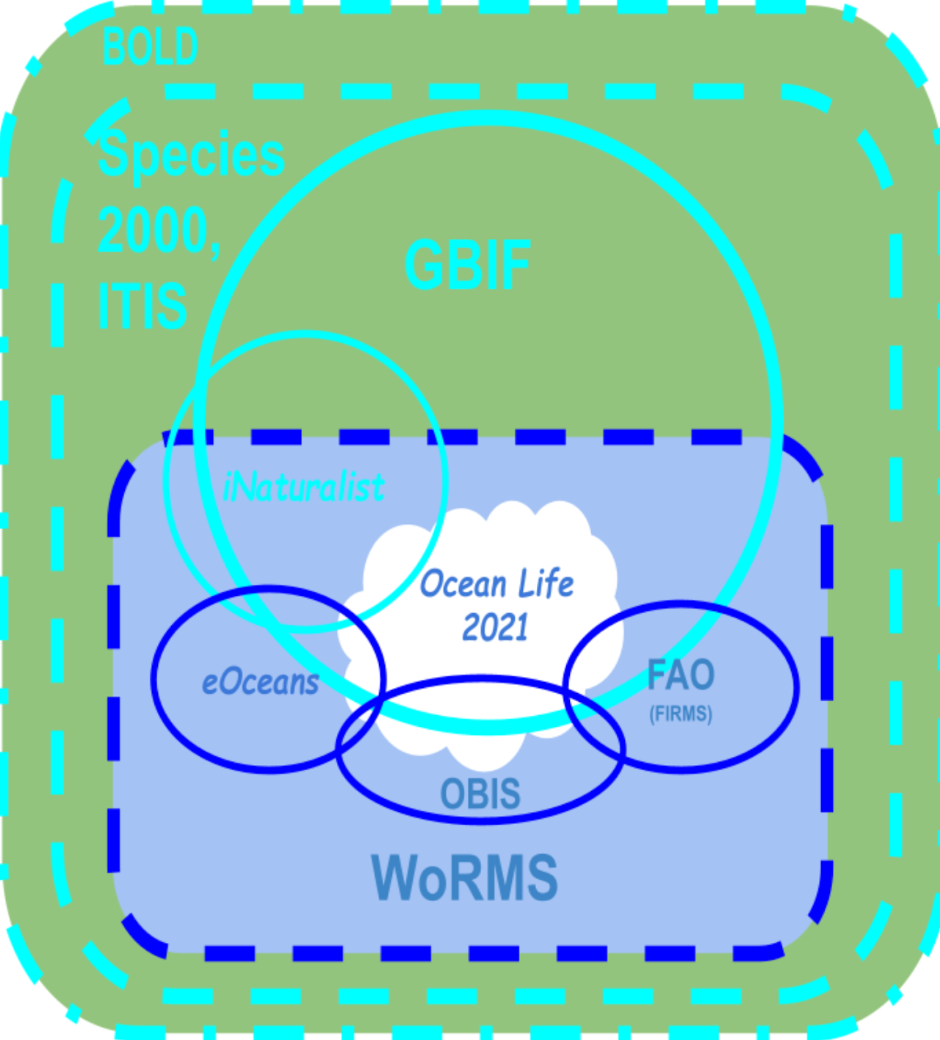
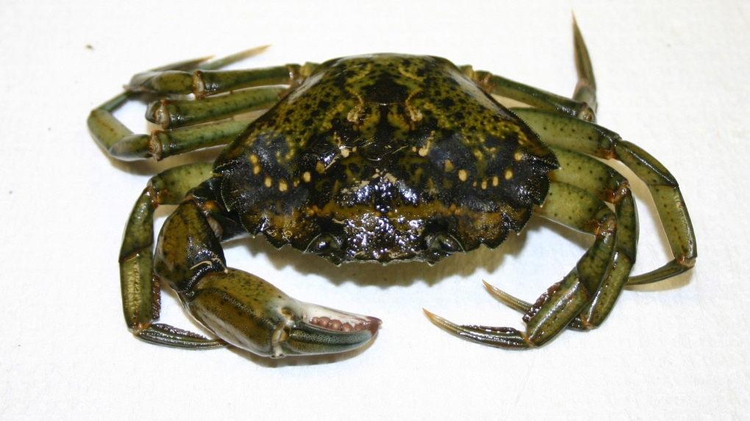
Ecosystem Change
Information Infrastructure
Invasive Species
“Removing green crab proves effective in controlling invasive species.”
HALIFAX, 2016 … trap invented by a local fisherman was used to catch more than two million green crab [Carcinus maenas Linnaeus, 1758] from one estuary over a few years. Since then, eelgrass [Zostera L.] in that estuary has recovered by about 34 per cent and soft-shell clam [Mya arenaria Linnaeus] populations are on the rise ...
Atlantic CTV News
Wikidata
What’s in a name? Wikidata, World_Register_of_Marine_Species#History, Taxonomy_(biology)#Taxonomic_descriptions , Taxonomy_mnemonic , Oceanlife-2021/domains...
Notes:
Green crabs are very adaptable, can go anywhere conditions are suitable and eat almost anything. Local folks here in NS are very interested in removing them from local waters. The image and text are from an original news item. I added the Scientific names in brackets from WoRMS and GBIF to illustrate variations in how scientific names might appear in literature. The diagram on the right reflects my view of global information infrastructure. At the centre is Ocean Life 2021, a list of 73 names used in my June ‘21 IOI lecture, to describe marine biodiversity information systems as a whole. Outside in, are the relevant open access systems including: BoLD (Barcode of Life Data System); SPECIES 2000 & ITIS (Integrated Taxonomic Information System); WoRMS (World Register of Marine Species); GBIF (Global Biodiversity Information Facility); OBIS (Ocean Biodiversity Information System), eOceans and FAO. Blue denotes marine systems, green terrestrial. Solid lines denote data in systems, dashed lines species names, red dotted line denotes the Wikidata collaborative content database. Wikidata link in red gives taxon-specific content including: common names, public domain images, and deep links to many but not all public sources. Coincidentally, this info which appears at the bottom of GBIF species page does not include OBIS. The other links at the bottom of the page generally talk about taxonomy. Needless to say, lots of duplication.

Slide 3
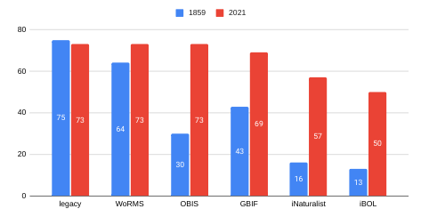
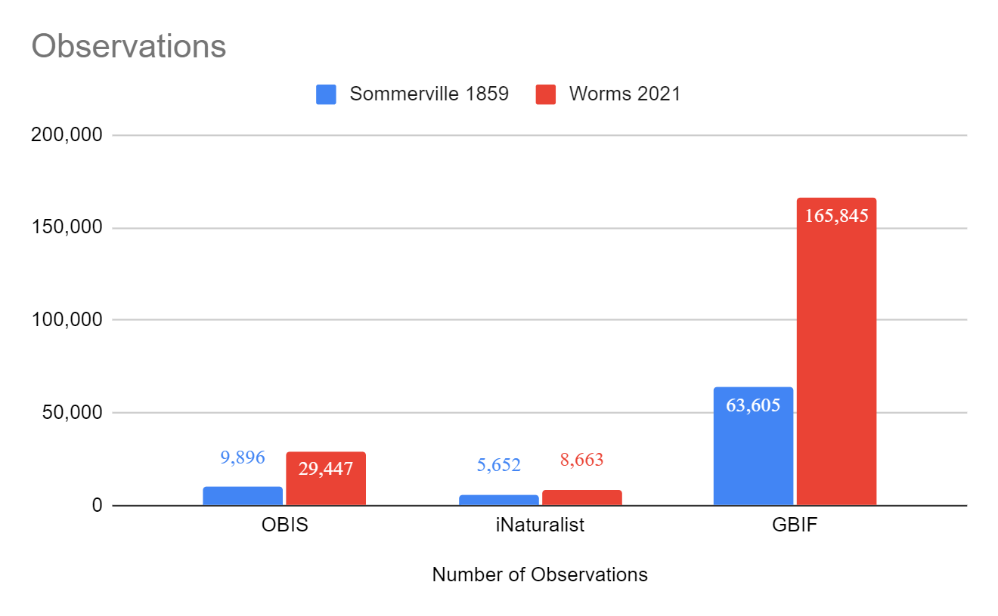
Challenges
Getting Names Right
Scientific names change over time*
55 of 73 Ocean Life 1859 scientificNames required updating …
Data are not all in one place ..
63 of 78m OBIS obs (~80%) and 13 of 40m iNat Research Grade obs (~33%) not on GBIF
WoRMS/OBIS.authority not = GBIF.authority
26 of 68 GBIF.authorities contained abbreviations, 14 of 68 GBIF.authorities did not include year . The GBIF search window rejected WoRMS/OBIS.scientificName that contained dates
Inconsistent approach between portals regarding data queries, downloads & citations
OBIS and GBIF downloads often too large for Google Sheets
Using World Registry of Marine Species (WORMS) accepted names greatly improve query results ...
See Oceanlife-2021/worms
Notes:
As part of a previous training lecture, I scanned an image of ‘Ocean Life - 1859 by J.M. Sommerville’ on the Internet Archive and created a Comma Separated Value (CSV) list containing 73 unique scientific names. It was a given that the names would be out of data and need updating. Working with this many species using 5 different interactive search windows was definitely a challenge. Working with the WoRMS and GBIF Taxon Match in tandem made the job more doable. Graph on the top right shows that all of the 73 names were found on WoRMS and that OBIS, GBIF, iNatural and iBold all returned superior results using the updated names in red as opposed to the originals shown in blue. Same for numbers of observations. See the link on the bottom right for more detail.

Slide 4


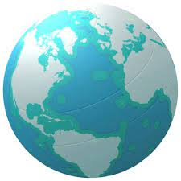
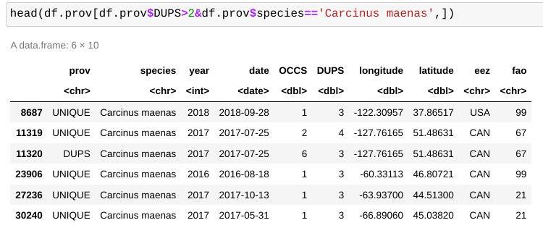
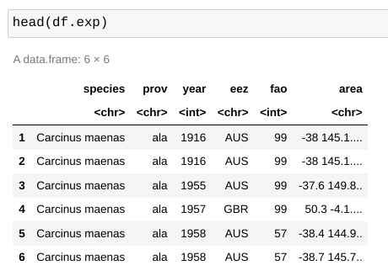
Using Data Science ...
*ocean.si.edu/ocean-life/5-invasive-species-you-should-know
* https://docs.ropensci.org/spocc/
*https://www.marineregions.org/
Species
Carcinus maenas [European Green Crab]*
Caulerpa taxifolia [Killer Algae]*
Codium fragile [Dead Man’s Fingers]
Dreissena polymorpha [Zebra Mussel]*
Mnemiopsis leidyi [Sea Walnut]*
Pterois volitans [Lion Fish]
Rapana venosa [Veined Rapa Whelk]*
Providers
ala - Atlas of Living Australia [AUS]*
bison - Biodiversity Information Serving Our Nation [USA]*
eBird - Cornell Lab of Ornithology {Global]
gbif - Global Biodiversity Information System [Global]*
idigbio - Integrated Digitized Biocollections [USA]*
inat - iNaturalist [Global]*
obis - Ocean Biodiversity Information System [Global]*
Vertnet - Distributed databases with a backbone
FAO*
Boundaries of the FAO Fishing Areas
See:https://www.marineregions.org/sources.php#fao
EEZ*
Marineregions: the intersect of the Exclusive Economic Zones and IHO ocean areas
See:https://www.marineregions.org/sources.php#ihoeez
Primary data products ...
Summary ...
Expanded / hybercube ...
See: species_style.r on GitHub
See: prepare_data.r on GitHub
Notes:
I next tried to level the playing field. My input was a short list of names taken from the Smithsonian Life’s ‘5 invasive species you should know!’ web page plus 2 that I had personally observed. WoRMS easily validated the scientific names, with Wikidata providing common names images. An R package named Spocc from rOpenSci (Open tools for open Science) directly extracted multiple species from multiple sources using the WoRMS names. MarineRegions.org provided 2 shapefiles: intersection of EEZ/IHO ocean polygons and FAO fishing areas. At the bottom of the slide are samples of resulting data, that is ‘Summary Data’ for mapping and ‘Expanded Hypercube’ for exploratory analysis. Click links at the bottom to see actual R code on GitHub.

Slide 5
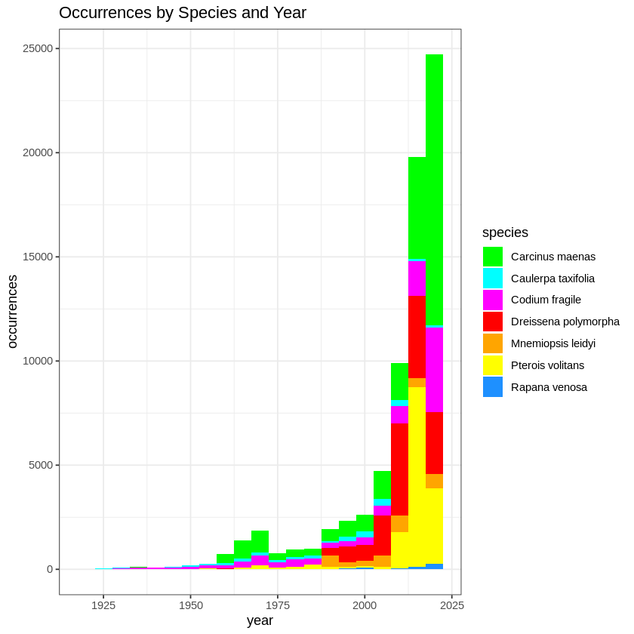
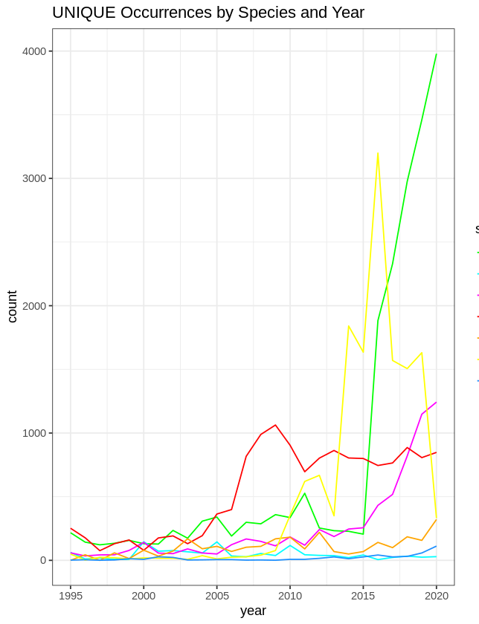
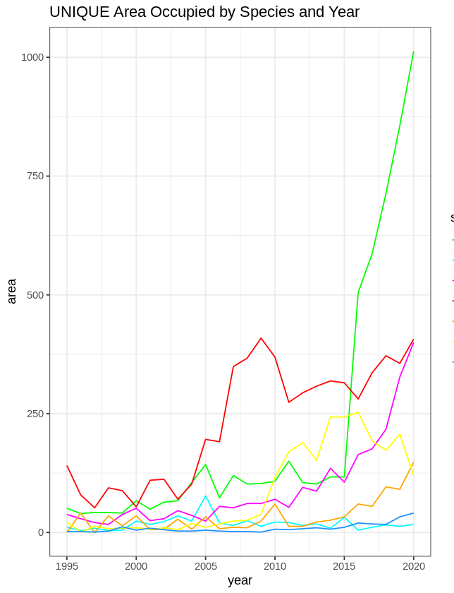
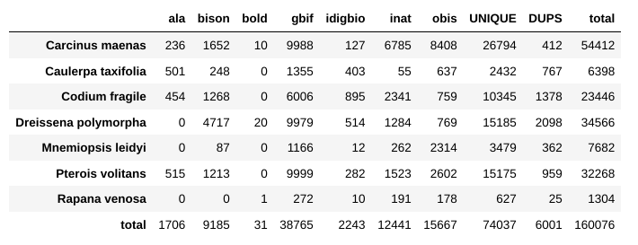
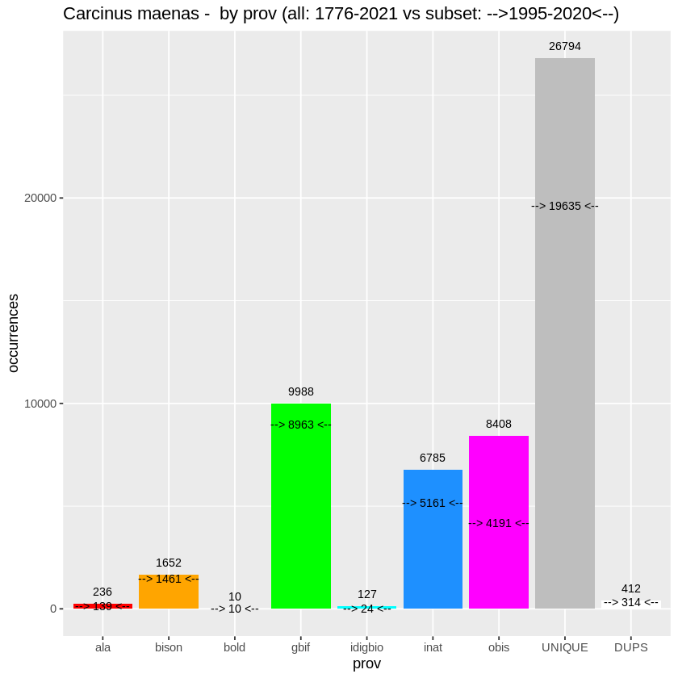
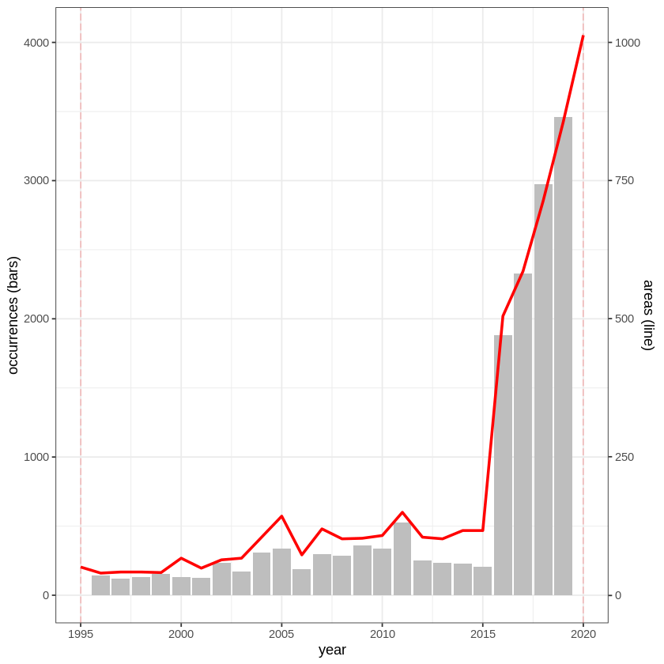
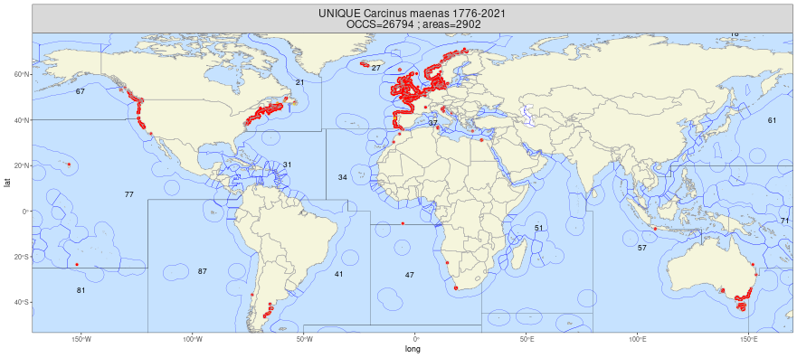
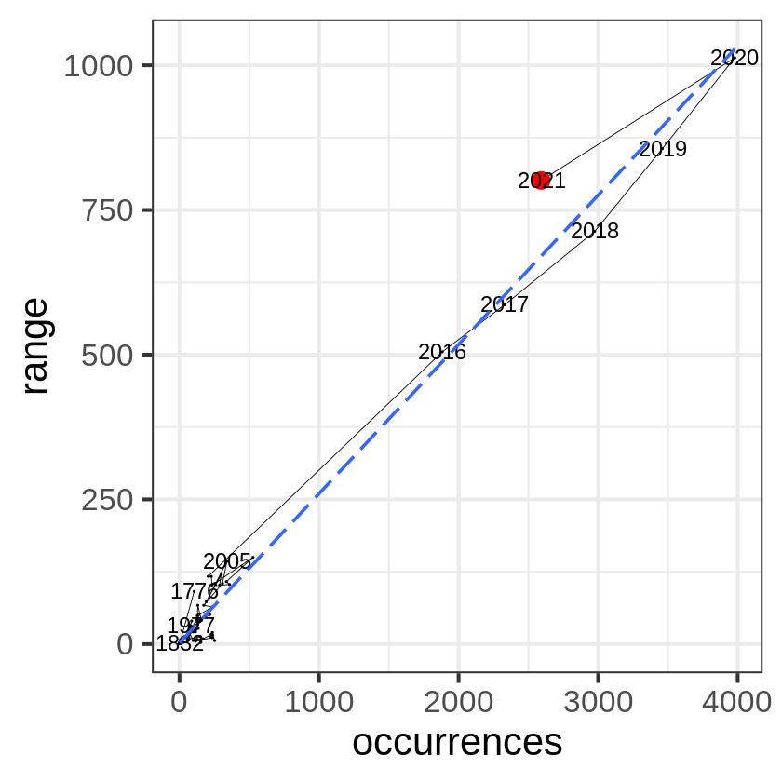
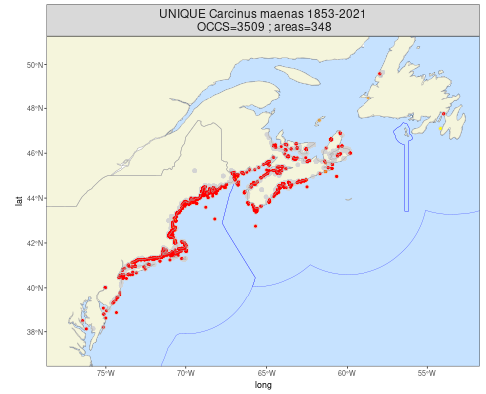
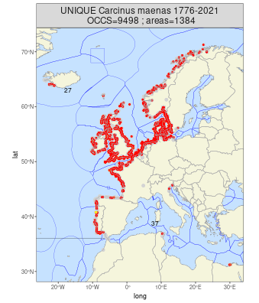
Visualizations ....
do.occ.line(,'UNIQUE',
1995,2020)
do.area.line(,'UNIQUE',
1995,2020)
do.bar('Car',1995,2020)
do.timeline('Car','UNIQUE',1995,2020)
do.map('UNIQUE','Car',)
do.compare('Car','UNIQUE')
See: https://ggplot2-book.org/introduction.html
See: Analytics.r on GitHub
Notes:
Here are typical exploration visualizations all produced with R’s ggplot package using data described on previous slide. The Hypercube feeds all but the maps. Top row gives a simple table and 3 summary graphics. A stacked bar chart showing occurrences by species over time and 2 line plots showing occurrences and area occupied. Bottom row gives slightly more complex visuals. First is a bar plot showing number of occurrences by source, with the total number given at top and time interval (i.e. 1995-2020) subtotals given in the body. The UNIQUE and DUP bars show combined occurrences and duplicates as calculated in the prepare data module. The second plot on the bottom has bars showing number of occurrences over time and the red line showing area occupied. The inset graph shows the time line of occurrences verus area (range). The maps on the right give different views of the occurrence data, that is Global, NWAltantic and NEAtlantic. Click link at the bottom right for actual R code on GitHub.

Slide 6
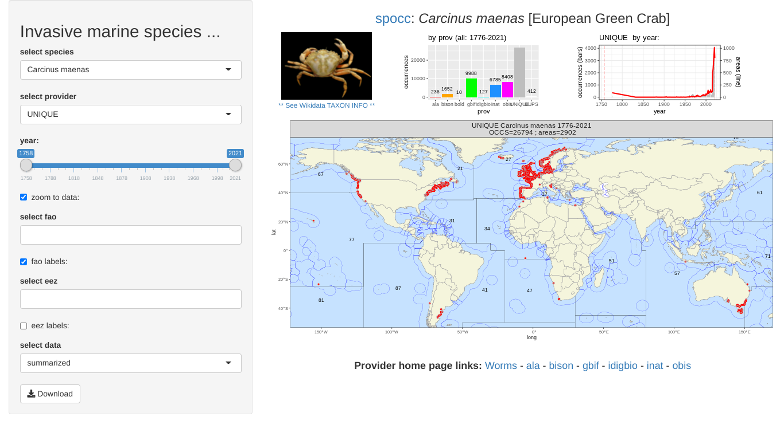
Dashboard / Control Panel
Live Access: https://rmbranto.shinyapps.io/invasives/
See: ShinyApps
See: dashboard on GitHub
Notes:
This is an interactive control panel style data explorer that I am currently working on. Change any object on the left and products on the right change accordingly, including optional zooming of the graphs and maps. The Species and Provider drop down selectors are single choice, whereas the FAO and EEZs selectors are multiple choice. The Timeline allows for selecting both start and end years. The visualizations shown here were described on the previous slide. The Data selector and Download button will result in a CSV file being placed in your download folder. Links at the bottom automatically select the desired species from each of the providers. This application is written in R and served from the RStudio’s ShinyApps server. Click links at the bottom for actual R code. I will do a demo at the end of my talk if we have time.

Slide 7



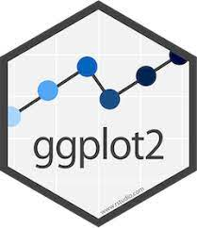


Recap ...
Software Components:
R: A highly programmable free computer environment under GNU General Public License;
Jupyter: Combine software code, computational output & explanatory text into a single document;
Spocc - (SPecies OCCurrence) query & collect species occurrence data from many sources;
ggplot - a general scheme for creating graphs and maps;
ShinyApp: build interactive web apps straight from R;
GitHub; where the world builds software;
Features and benefits:
Queries species occurrence data from available providers using list of WoRMS accepted names
Generates synthetic UNIQUE / DUPlicate data objects from available provider data
Generates provider specific Taxon IDs and Keys and so formulate the deep links into live provider portals
Filter and zoom maps and graphs using list of Providers, date range, FAO fishing Area and EEZs
Challenges:
Spocc queries limited to 9999 occurrence records per species and provider
bison and inigbio providers do not support deep linking by species and or taxon key/id
using EEZ and FAO shapefiles for Pacific centred mapping
See: Data Science on a Chromebook
See: github.com/rmbranto/CoastGIS2021
Notes:
All of the R software components are freely downloadable, while ShinyApp and GitHub are web services, free for personal use. Overall the R / Jupyter based approach gives a finer degree of control and better reproducibility than when using spreadsheets to process data. The link on the bottom left provides very good instructions for installing R and Jupyter on a chromebook. I don’t think that I would have started down this road if it were not for this website. The link to Github on the bottom left takes you to the GitHub CoastGIS2021 repository containing all relevant materials for this project. As for features and benefits, Spocc appeared to work well with the short list WoRMS names. I just recently tried using the 73 species Oceanlife-2021 and got what appeared to be reasonable results. More on that at a later date. In any case you are free to look at, download and reuse any of these materials. Feedback would certainly be appreciated.

Slide 8
Last slide
Conclusion
Continue preparing for IOI 2022 ...
More testing and refinement
Add provider API links to dashboard
Experiment with single species control panel
Creation and use of defined area polygon queries
Optional eez/fao and/or
Seek collaborations …
marine plants, trawl bycatch species lists
Create vignette for OpenSci
Create wikipedia content
Demos
Dashboard
GitHub
Hyperslide
Wikidata
Notes:
I expect to continue preparing for IOI 2022, that is more testing and refinement, add provider API (application program interface) download links to dashboard, create lists for marine plants and trawl fisheries bycatch, experiment with single species control panel and experiment with the creation and use of defined area polygon queries. As for seeking collaborations, create an extended abstract for this talk, which I then submit as a vignette to rOpenSci or else as wikipedia content. Now for some demos ...

Slide 9
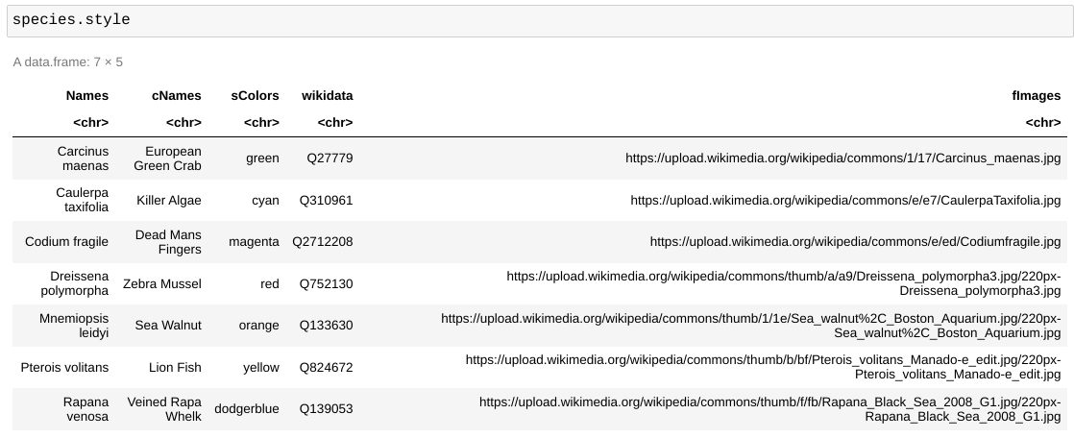
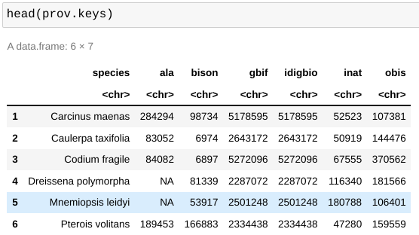
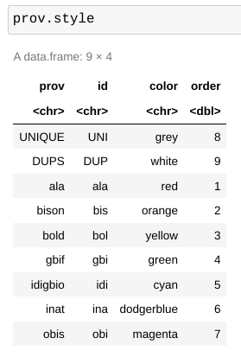
Appendices: synthetic data objects

